Slide 1
C++ Coroutines: Under the covers
BFF
Amazing coroutine disappearing act

Slide 2

Only at CppCon!
Amazing coroutine disappearing act !
Magic secrets revealed!
Microsoft Visual C++ Team
Gor Nishanov
Ubuntu LTS 16.04
clang 4.0 (forked)
llvm 4.0 (trunk)

Slide 3
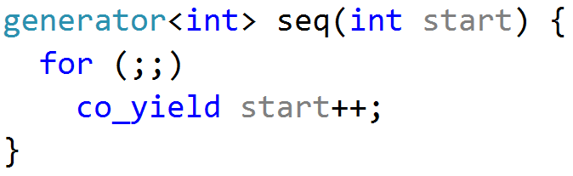
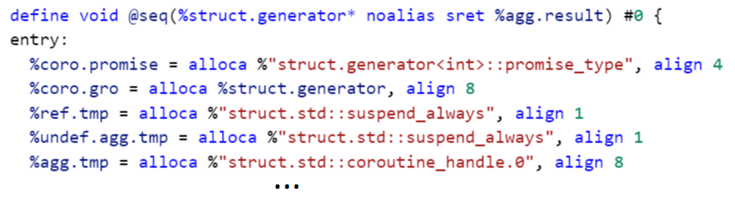
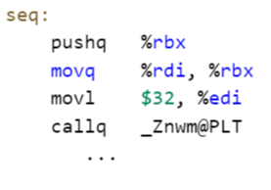
Compiler
Frontend
Optimizer
Codegen

Slide 4
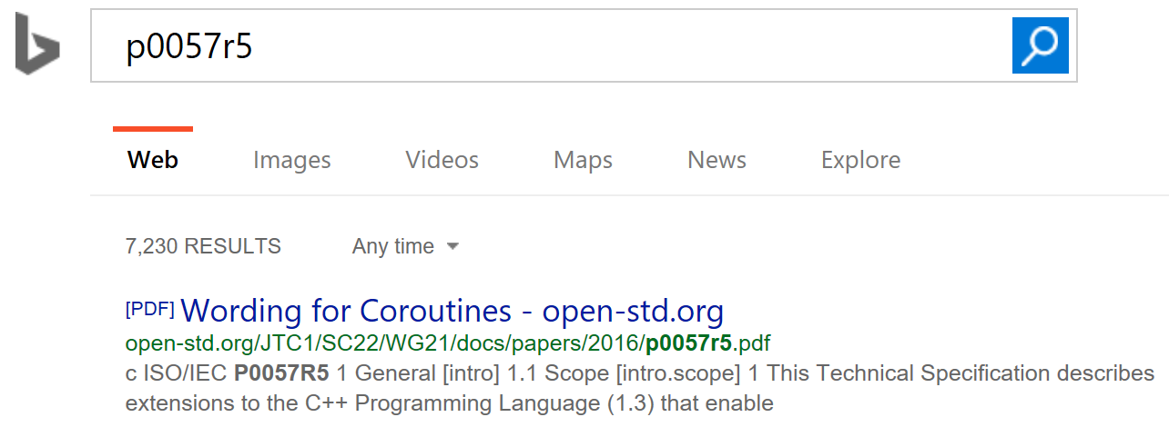
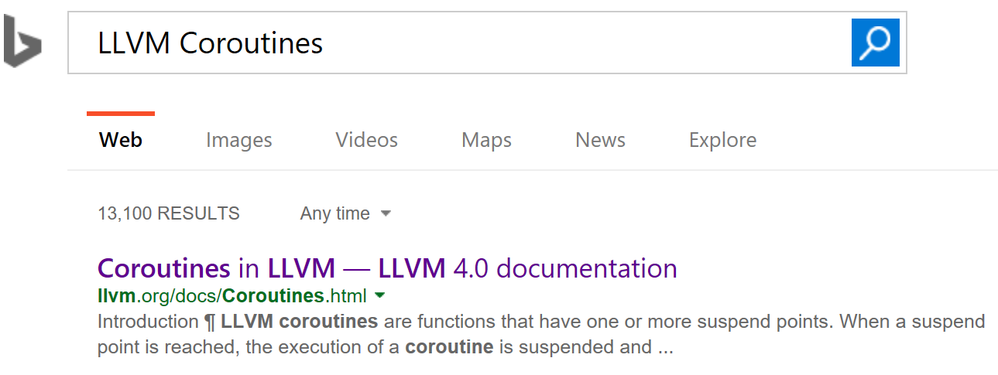
Two kind of coroutines
C++ Coroutines: co_await, co_yield
LLVM Coroutines:
llvm.coro.begin
llvm.coro.suspend
llvm.coro.end
llvm.coro.resume
llvm.coro.destroy

Slide 5
Two kind of coroutines
C++ Coroutines: co_await, co_yield
Clang++
C and __builtin_xxx
LLVM Coroutines:
llvm.coro.begin
llvm.coro.suspend
llvm.coro.end
llvm.coro.resume
llvm.coro.destroy
Optimizer
(LLVM IR)

Slide 6
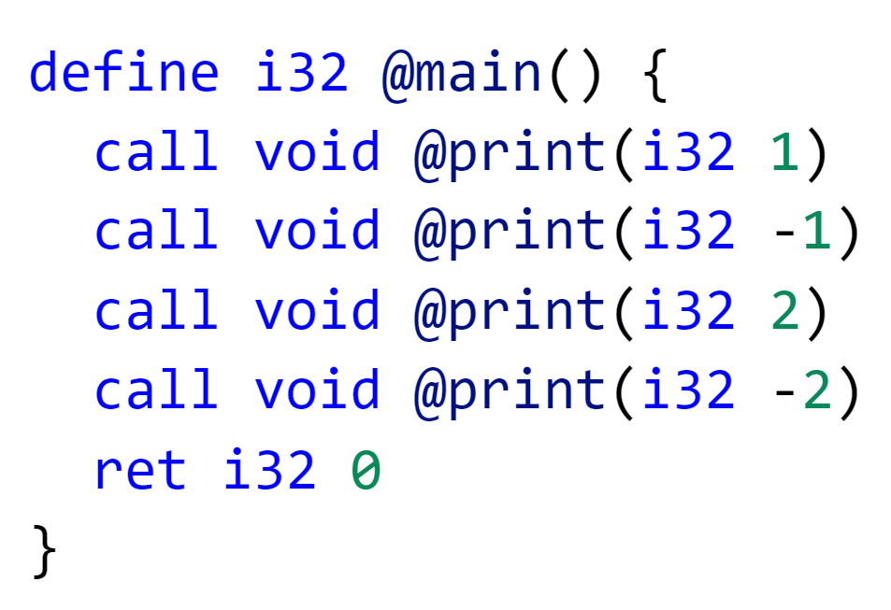
Coroutines in C
int main() {
void* coro = f(1);
for (int i = 0; i < 4; ++i) {
CORO_RESUME(coro);
}
CORO_DESTROY(coro);
}
void* f(int n) {
void* hdl = CORO_BEGIN(malloc);
for (int i = n;; ++i) {
CORO_SUSPEND(hdl);
print(i);
CORO_SUSPEND(hdl);
print(-i);
}
CORO_END(hdl, free);
}
1, -1, 2, -2, 3, -3, …

Slide 7
coroutine transformation

Slide 8
Build Coroutine Frame
void* f(int n) {
void* hdl = CORO_BEGIN(malloc);
for (int i = n;; ++i) {
CORO_SUSPEND(hdl);
print(i);
CORO_SUSPEND(hdl);
print(-i);
}
CORO_END(hdl, free);
}
struct f.frame {
int i;
};
1, -1, 2, -2, 3, -3, …

Slide 9
Rewrite access to spilled variables
void* f(int n) {
void* hdl = CORO_BEGIN(malloc);
for (int i = n;; ++i) {
CORO_SUSPEND(hdl);
print(i);
CORO_SUSPEND(hdl);
print(-i);
}
CORO_END(hdl, free);
}
struct f.frame {
int i;
};

Slide 10
Rewrite access to spilled variables
void* f(int n) {
void* hdl = CORO_BEGIN(malloc);
f.frame* frame = (f.frame*)hdl;
for (frame->i = n;; ++frame->i) {
CORO_SUSPEND(hdl);
print(frame->i);
CORO_SUSPEND(hdl);
print(-frame->i);
}
CORO_END(hdl, free);
}
struct f.frame {
int i;
};

Slide 11
Create jump points
void* f(int n) {
void* hdl = CORO_BEGIN(malloc);
f.frame* frame = (f.frame*)hdl;
for (frame->i = n;; ++frame->i) {
CORO_SUSPEND(hdl);
print(frame->i);
CORO_SUSPEND(hdl);
print(-frame->i);
}
CORO_END(hdl, free);
}
struct f.frame {
int i;
};

Slide 12
Create jump points
void* f(int n) {
void* hdl = CORO_BEGIN(malloc);
f.frame* frame = (f.frame*)hdl;
for (frame->i = n;; ++frame->i) {
CORO_SUSPEND(hdl);
print(frame->i);
CORO_SUSPEND(hdl);
print(-frame->i);
}
CORO_END(hdl, free);
}
struct f.frame {
int suspend_index;
int i;
};

Slide 13
Create jump points
void* f(int n) {
void* hdl = CORO_BEGIN(malloc);
f.frame* frame = (f.frame*)hdl;
for (frame->i = n;; ++frame->i) {
frame->suspend_index = 0;
r0: CORO_SUSPEND(hdl);
print(frame->i);
frame->suspend_index = 1;
r1: CORO_SUSPEND(hdl);
print(-frame->i);
}
CORO_END(hdl, free);
}
struct f.frame {
int suspend_index;
int i;
};

Slide 14
split coroutine
void* f(int n) {
void* hdl = CORO_BEGIN(malloc);
…
return hdl;
}
void* f(int n) {
void* hdl = CORO_BEGIN(malloc);
f.frame* frame = (f.frame*)hdl;
for (frame->i = n;; ++frame->i) {
frame->suspend_index = 0;
r0: CORO_SUSPEND(hdl);
print(frame->i);
frame->suspend_index = 1;
r1: CORO_SUSPEND(hdl);
print(-frame->i);
}
CORO_END(hdl, free);
}
Coroutine Start Function
void f.resume(f.frame* frame) {
switch(frame->suspend_index){
…
}
}
Coroutine Resume Function
void f.destroy(f.frame* frame) {
switch(frame->suspend_index){
…
}
free(frame);
}
Coroutine Destroy Function

Slide 15
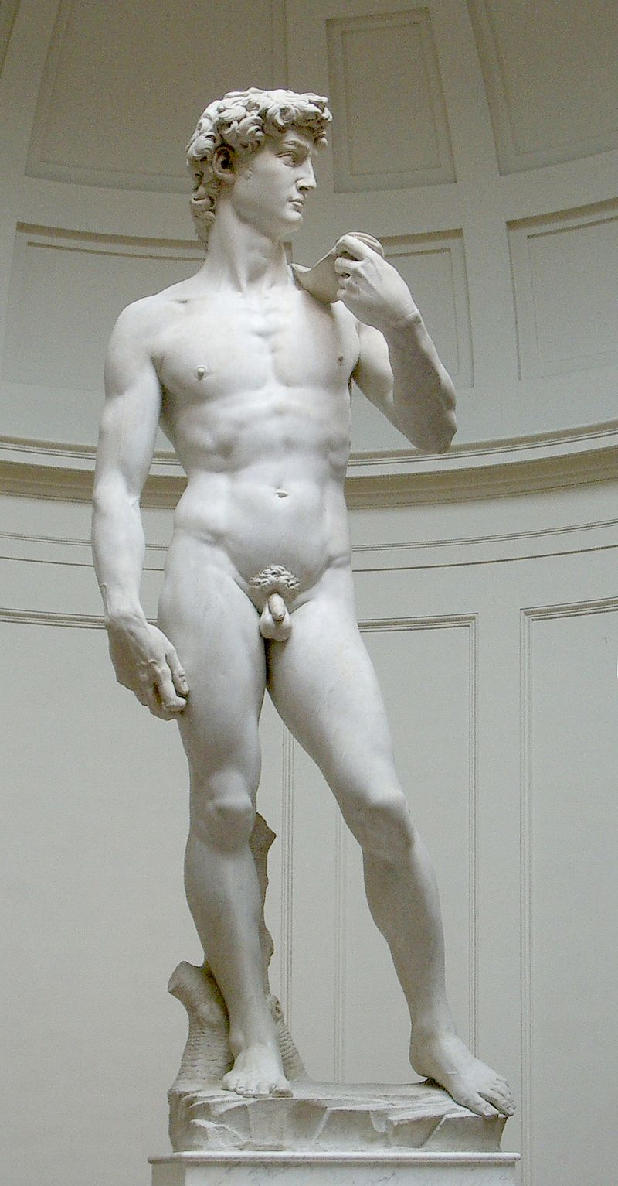


BEAUTY is purgation of superfluities

Slide 16
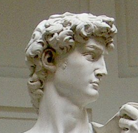
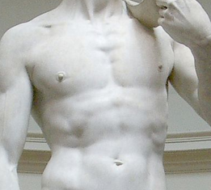
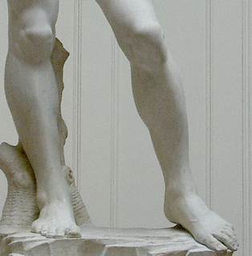
BEAUTY is purgation of superfluities
Coroutine Start Function
Coroutine Destroy Function
Coroutine Resume Function

Slide 17
Create resume clone
void* f(int n) {
void* hdl = CORO_BEGIN(malloc);
f.frame* frame = (f.frame*)hdl;
for (frame->i = n;; ++frame->i) {
frame->suspend_index = 0;
r0: CORO_SUSPEND(hdl);
print(frame->i);
frame->suspend_index = 1;
r1: CORO_SUSPEND(hdl);
print(-frame->i);
}
CORO_END(hdl, free);
}
void* f’(int n) {
void* hdl = CORO_BEGIN(malloc);
f.frame* frame = (f.frame*)hdl;
for (frame->i = n;; ++frame->i) {
frame->suspend_index = 0;
r0: CORO_SUSPEND(hdl);
print(frame->i);
frame->suspend_index = 1;
r1: CORO_SUSPEND(hdl);
print(-frame->i);
}
CORO_END(hdl, free);
}
Clone

Slide 18
Create resume clone
void* f(int n) {
void* hdl = CORO_BEGIN(malloc);
f.frame* frame = (f.frame*)hdl;
for (frame->i = n;; ++frame->i) {
frame->suspend_index = 0;
r0: CORO_SUSPEND(hdl);
print(frame->i);
frame->suspend_index = 1;
r1: CORO_SUSPEND(hdl);
print(-frame->i);
}
CORO_END(hdl, free);
}
void f.resume(f.frame* frame) {
switch (frame->suspend_index) {
case 0: goto r0;
default: goto r1;
}
for (frame->i = n;; ++frame->i) {
frame->suspend_index = 0;
r0: CORO_SUSPEND(hdl);
print(frame->i);
frame->suspend_index = 1;
r1: CORO_SUSPEND(hdl);
print(-frame->i);
}
CORO_END(hdl, free);
}
void f.cleanup(f.frame* frame) {
switch (frame->suspend_index) {
case 0: goto r0;
default: goto r1;
}
for (frame->i = n;; ++frame->i) {
frame->suspend_index = 0;
r0: CORO_SUSPEND(hdl);
print(frame->i);
frame->suspend_index = 1;
r1: CORO_SUSPEND(hdl);
print(-frame->i);
}
CORO_END(hdl, free);
}
void f.destroy(f.frame* frame) {
switch (frame->suspend_index) {
case 0: goto r0;
default: goto r1;
}
for (frame->i = n;; ++frame->i) {
frame->suspend_index = 0;
r0: CORO_SUSPEND(hdl);
print(frame->i);
frame->suspend_index = 1;
r1: CORO_SUSPEND(hdl);
print(-frame->i);
}
CORO_END(hdl, free);
}

Slide 19
purgation of superfluities
#define CORO_SUSPEND() \
switch (__builtin_coro_suspend()) { \
case -1: \
goto coro_Suspend; \
case 1: \
goto coro_Cleanup; \
default: \
break; \
}
#define CORO_END(hdl, FreeFunc) \
coro_Cleanup : { \
void *coro_mem = __builtin_coro_free(hdl);\
if (coro_mem) \
FreeFunc(coro_mem); \
} \
coro_Suspend: \
__builtin_coro_end(); \
return coro_hdl;
__builtin_coro_suspend()
-1 | In start function
0 | In resume function
1 | In destroy and cleanup functions
__builtin_coro_free()
0 | In cleanup function
hdl | elsewhere

Slide 20
After Cleanup
void* f(int *n) {
void* hdl = CORO_BEGIN(malloc);
f.frame* frame = (f.frame*)hdl;
frame->ResumeFn = &f.resume;
frame->DestroyFn = &f.destroy;
frame->i = n; frame->suspend_index = 0;
return coro_hdl;
}
struct f.frame {
FnPtr ResumeFn;
FnPtr DestroyFn;
int suspend_index;
int i;
};
void f.resume(f.frame* frame) {
if (frame->index == 0) {
print(frame->i);
frame->suspend_index = 1;
}
else {
print(-frame->i);
++frame->i;
frame->suspend_index = 0;
}
}
void f.destroy(f.frame* frame) {
free(frame);
}
void f.cleanup(f.frame* frame) {}

Slide 21
Optimizing Coroutines

Slide 22
Inlining
int main() {
void* coro = f(1);
CORO_RESUME(coro);
CORO_RESUME(coro);
CORO_DESTROY(coro);
}
int main() {
void* coro = CORO_BEGIN(malloc);
f.frame* frame = (f.frame*)coro;
frame->ResumeFn = &f.resume;
frame->DestroyFn = &f.destroy;
frame->i = 1; frame->suspend_index = 0;
CORO_RESUME(coro);
CORO_RESUME(coro);
CORO_DESTROY(coro);
}
void* f(int n) {
void* hdl = CORO_BEGIN(malloc);
f.frame* frame = (f.frame*)hdl;
frame->ResumeFn = &f.resume;
frame->DestroyFn = &f.destroy;
frame->i = n; frame->suspend_index = 0;
return coro_hdl;
}

Slide 23
Devirtualization
int main() {
void* coro = f();
CORO_RESUME(coro);
CORO_RESUME(coro);
CORO_DESTROY(coro);
}
int main() {
void* coro = CORO_BEGIN(malloc);
f.frame* frame = (f.frame*)coro;
frame->ResumeFn = &f.resume;
frame->DestroyFn = &f.destroy;
frame->i = 1; frame->suspend_index = 0;
CORO_RESUME(coro);
CORO_RESUME(coro);
CORO_DESTROY(coro);
}
void* f(int *n) {
void* hdl = CORO_BEGIN(malloc);
f.frame* frame = (f.frame*)hdl;
frame->ResumeFn = &f.resume;
frame->DestroyFn = &f.destroy;
frame->i = n; frame->suspend_index = 0;
return coro_hdl;
}

Slide 24
Devirtualization
int main() {
void* coro = f();
CORO_RESUME(coro);
CORO_RESUME(coro);
CORO_DESTROY(coro);
}
int main() {
void* coro = CORO_BEGIN(malloc);
f.frame* frame = (f.frame*)coro;
frame->ResumeFn = &f.resume;
frame->DestroyFn = &f.destroy;
frame->i = 1; frame->suspend_index = 0;
f.resume(coro);
f.resume(coro);
f.destroy(coro);
}
void* f(int *n) {
void* hdl = CORO_BEGIN(malloc);
f.frame* frame = (f.frame*)hdl;
frame->ResumeFn = &f.resume;
frame->DestroyFn = &f.destroy;
frame->i = n; frame->suspend_index = 0;
return coro_hdl;
}

Slide 25
Heap Allocation Elision
int main() {
void* coro = f();
CORO_RESUME(coro);
CORO_RESUME(coro);
CORO_DESTROY(coro);
}
int main() {
void* coro = CORO_BEGIN(malloc);
f.frame* frame = (f.frame*)coro;
frame->ResumeFn = &f.resume;
frame->DestroyFn = &f.destroy;
frame->i = 1; frame->suspend_index = 0;
f.resume(coro);
f.resume(coro);
f.destroy(coro);
}
void* f(int *n) {
void* hdl = CORO_BEGIN(malloc);
f.frame* frame = (f.frame*)hdl;
frame->ResumeFn = &f.resume;
frame->DestroyFn = &f.destroy;
frame->i = n; frame->suspend_index = 0;
return coro_hdl;
}

Slide 26
Heap Allocation Elision
int main() {
void* coro = f();
CORO_RESUME(coro);
CORO_RESUME(coro);
CORO_DESTROY(coro);
}
int main() {
void* coro = alloca(sizeof(f.frame));
f.frame* frame = (f.frame*)coro;
frame->ResumeFn = &f.resume;
frame->DestroyFn = &f.destroy;
frame->i = n; frame->suspend_index = 0;
f.resume(coro);
f.resume(coro);
f.cleanup(coro);
}
void* f(int *n) {
void* hdl = CORO_BEGIN(malloc);
f.frame* frame = (f.frame*)hdl;
frame->ResumeFn = &f.resume;
frame->DestroyFn = &f.destroy;
frame->i = n; frame->suspend_index = 0;
return coro_hdl;
}

Slide 27
Non-coroutine related optimizations finish the job

Slide 28
More Inlining
int main() {
void* coro = alloca(sizeof(f.frame));
f.frame* frame = (f.frame*)coro;
frame->ResumeFn = &f.resume;
frame->DestroyFn = &f.destroy;
frame->i = 1; frame->suspend_index = 0;
if (frame->suspend_index == 0) {
print(frame->i);
frame->suspend_index = 1;
}
else {
print(-frame->i);
++frame->i;
frame->suspend_index = 0;
}
if (frame->suspend_index == 0) {
print(frame->i);
frame->suspend_index = 1;
}
else {
print(-frame->i);
++frame->i;
frame->suspend_index = 0;
}
}
int main() {
void* coro = alloca(sizeof(f.frame));
f.frame* frame = (f.frame*)coro;
frame->ResumeFn = &f.resume;
frame->DestroyFn = &f.destroy;
frame->i = n; frame->suspend_index = 0;
f.resume(coro);
f.resume(coro);
f.cleanup(coro);
}
void f.resume(f.frame* frame) {
if (frame->index == 0) {
print(frame->i);
frame->suspend_index = 1;
}
else {
print(-frame->i);
++frame->i;
frame->suspend_index = 0;
}
}

Slide 29
SROA Scalar Replacement of Aggregates
int f() {
struct Point {
int X;
int Y;
};
Point p;
p.X = 1;
p.Y = 2;
return p.X + p.Y;
}
p_addr = &p
x_addr = p_addr + offset of Point::X
STORE 1, x_addr
y.addr = p.addr + offset of Point::Y
%y = LOAD y.addr

Slide 30
SROA Scalar Replacement of Aggregates
and Ssa
int f() {
struct Point {
int X;
int Y;
};
Point p;
const int p_X = 1;
const int p_Y = 2;
return p_X + p_Y;
}

Slide 31
ssa complication 1
int X = 1;
X = X + 1;
print(X);
const int X = 1;
const int X₁ = X + 1;
print(X₁)

Slide 32
ssa complication 2
entry:
int X = 1;
loop:
X = X + 1;
print(X);
goto loop;
entry:
const int X = 1;
loop:
const int X₁ = X? + 1;
print(X₁);
goto X;
X? = PHI(entry: X, loop: X₁)

Slide 33
SROA Scalar Replacement of Aggregates
int main() {
void* coro = alloca(sizeof(f.frame));
f.frame* frame = (f.frame*)coro;
frame->ResumeFn = &f.resume;
frame->DestroyFn = &f.destroy;
frame->i = 1; frame->suspend_index = 0;
if (frame->suspend_index == 0) {
print(frame->i);
frame->suspend_index = 1;
}
else {
print(-frame->i);
++frame->i;
frame->suspend_index = 0;
}
if (frame->suspend_index == 0) {
print(frame->i);
frame->suspend_index = 1;
}
else {
print(-frame->i);
++frame->i;
frame->suspend_index = 0;
}
}
int main() {
const auto* ResumeFn = &f.resume;
const auto* DestroyFn = &f.destroy;
const int i = 1; const int suspend_index = 0;
if (suspend_index == 0)
bb1: print(i);
else
bb2: print(-i);
const int i1 = FROM(bb1) ? i : i + 1; const int suspend_index1 =
FROM(bb1) ? 1 : 0;
if (suspend_index1 == 0)
bb3: print(i1);
else
bb4: print(-i1);
const int i2 = FROM(bb3) ? i1 : i1 + 1; const int suspend_index2 =
FROM(bb3) ? 1 : 0;
}

Slide 34
Dead Code Elimination
int main() {
const auto* ResumeFn = &f.resume;
const auto* DestroyFn = &f.destroy;
const int i = 1; const int suspend_index = 0;
if (suspend_index == 0)
bb1: print(i);
else
bb2: print(-i);
const int i1 = FROM(bb1) ? i : i + 1; const int suspend_index1 =
FROM(bb1) ? 1 : 0;
if (suspend_index1 == 0)
bb3: print(i1);
else
bb4: print(-i1);
const int i2 = FROM(bb3) ? i1 : i1 + 1; const int suspend_index2 =
FROM(bb3) ? 1 : 0;
}

Slide 35
Dead Code Elimination
int main() {
const int i = 1; const int suspend_index = 0;
if (suspend_index == 0)
bb1: print(i);
else
bb2: print(-i);
const int i1 = FROM(bb1) ? i : i + 1; const int suspend_index1 = FROM(bb1) ? 1 : 0;
if (suspend_index1 == 0)
bb3: print(i1);
else
bb4: print(-i1);
}

Slide 36
Constant Propagation
int main() {
const int i = 1; const int suspend_index = 0;
if (suspend_index == 0)
bb1: print(i);
else
bb2: print(-i);
const int i1 = FROM(bb1) ? i : i + 1; const int suspend_index1 = FROM(bb1) ? 1 : 0;
if (suspend_index1 == 0)
bb3: print(i1);
else
bb4: print(-i1);
}

Slide 37
Constant Propagation
int main() {
const int i = 1; const int suspend_index = 0;
if (suspend_index == 0)
bb1: print(i);
else
bb2: print(-i);
const int i1 = FROM(bb1) ? i : i + 1; const int suspend_index1 = FROM(bb1) ? 1 : 0;
if (suspend_index1 == 0)
bb3: print(i1);
else
bb4: print(-i1);
}

Slide 38
Constant Propagation
int main() {
if (0 == 0)
bb1: print(1);
else
bb2: print(-1);
const int i1 = FROM(bb1) ? 1 : 1 + 1; const int suspend_index1 = FROM(bb1) ? 1 : 0;
if (suspend_index1 == 0)
bb3: print(i1);
else
bb4: print(-i1);
}

Slide 39
Simplify Control Flow
int main() {
bb1: print(1);
const int i1 = 1; const int suspend_index1 = 1;
if (suspend_index1 == 0)
bb3: print(i1);
else
bb4: print(-i1);
}

Slide 40
One more time
int main() {
bb1: print(1);
bb4: print(-1);
}

Slide 41
What about async coroutines?

Slide 42
Compiler
Frontend
Optimizer
Codegen

Slide 43
Zooming into an optimizer
CGSCC PM
-forceattrs -inferattrs -ipsccp -globalopt -domtree -mem2reg -deadargelim -domtree -basicaa -aa -instcombine -simplifycfg -pgo-icall-prom -basiccg -globals-aa -prune-eh -inline -functionattrs -coro-split -domtree -sroa -early-cse -speculative-execution -lazy-value-info -jump-threading -correlated-propagation -simplifycfg -domtree -basicaa -aa -instcombine -tailcallelim -simplifycfg -reassociate -domtree -loops -loop-simplify -lcssa -basicaa -aa -scalar-evolution -loop-rotate -licm -loop-unswitch -simplifycfg -domtree -basicaa -aa -instcombine -loops -loop-simplify -lcssa -scalar-evolution -indvars -loop-idiom -loop-deletion -loop-unroll -mldst-motion -aa -memdep -gvn -basicaa -aa -memdep -memcpyopt -sccp -domtree -demanded-bits -bdce -basicaa -aa -instcombine -lazy-value-info -jump-threading -correlated-propagation -domtree -basicaa -aa -memdep -dse -loops -loop-simplify -lcssa -aa -scalar-evolution -licm -coro-elide -postdomtree -adce -simplifycfg -domtree -basicaa -aa -instcombine
Late Passes:
-elim-avail-extern -basiccg -rpo-functionattrs -globals-aa -float2int -domtree -loops -loop-simplify -lcssa -basicaa -aa -scalar-evolution -loop-rotate -loop-accesses -lazy-branch-prob -lazy-block-freq -opt-remark-emitter -loop-distribute -loop-simplify -lcssa -branch-prob -block-freq -scalar-evolution -basicaa -aa -loop-accesses -demanded-bits -lazy-branch-prob -lazy-block-freq -opt-remark-emitter -loop-vectorize -loop-simplify -scalar-evolution -aa -loop-accesses -loop-load-elim -basicaa -aa -instcombine -scalar-evolution -demanded-bits -slp-vectorizer -simplifycfg -domtree -basicaa -aa -instcombine -loops -loop-simplify -lcssa -scalar-evolution -loop-unroll -instcombine -loop-simplify -lcssa -scalar-evolution -licm -instsimplify -scalar-evolution -alignment-from-assumptions -strip-dead-prototypes -globaldce -constmerge -coro-cleanup
Early Passes:
-simplifycfg –domtree
-sroa -early-cse
-memoryssa -gvn-hoist

Slide 44
CGSCC Pass Manager
main
a
e
b
c
d
f
g
h
k
aa

Slide 45
CGSCC Pass Manager
main
a
e
b
c
d
f
g
h
k
aa
Step 1: Optimize purple

Slide 46
CGSCC Pass Manager
main
a
e
b
c
d
f
g
h
k
aa
Step 1: Optimize purple
Step 2: Optimize gray

Slide 47
CGSCC Pass Manager
main
a
e
b
c
d
f
g
h
k
aa
Step 1: Optimize purple
Step 2: Optimize gray
Step 3: Optimize green

Slide 48
CGSCC Pass Manager
main
a
e
b
c
d
f
g
h
k
aa
Step 1: Optimize purple
Step 2: Optimize gray
Step 3: Optimize green
Step 4: Optimize yellow

Slide 49
Optimizing a single SCC
Inliner
PruneEH
FnAttr
…
Devirtization
Detector
sroa
cse
…. 75 more functional passes …
…
x4

Slide 50
Optimizing a single SCC
1. Build Coroutine Frame
2. Split Coroutine into
start
resume
destroy
Devirtualize Resume/Destroy
Elide Heap Allocations
Inliner
PruneEH
FnAttr
CoroSplit
Devirtization
Detector
sroa
cse
…. 75 more functional passes …
CoroElide
x4

Slide 51
Optimizing a single SCC
Inliner
PruneEH
FnAttr
CoroSplit
Devirtization
Detector
sroa
cse
…. 75 more functional passes …
CoroElide
void* f(int n) {
void* hdl = CORO_BEGIN(malloc);
for (int i = n;; ++i) {
CORO_SUSPEND(hdl);
print(i);
CORO_SUSPEND(hdl);
print(-i);
}
CORO_END(hdl, free);
}
x4

Slide 52
Optimizing a single SCC
Inliner
void* f(int *n) {
void* hdl = CORO_BEGIN(malloc);
f.frame* frame = (f.frame*)hdl;
frame->ResumeFn = &f.resume;
frame->DestroyFn = &f.destroy;
frame->i = n; frame->suspend_index = 0;
return coro_hdl;
}
PruneEH
FnAttr
CoroSplit
Devirtization
Detector
sroa
cse
…. 75 more functional passes …
CoroElide
void f.resume(f.frame* frame) {
if (frame->index == 0) {
print(frame->i);
frame->suspend_index = 1;
}
else {
print(-frame->i);
++frame->i;
frame->suspend_index = 0;
}
}
void f.destroy(f.frame* frame) {
free(frame);
}
x4

Slide 53
Optimizing a single SCC
Inliner
void* f(int *n) {
void* hdl = CORO_BEGIN(malloc);
f.frame* frame = (f.frame*)hdl;
frame->ResumeFn = &f.resume;
frame->DestroyFn = &f.destroy;
frame->i = n; frame->suspend_index = 0;
return coro_hdl;
}
PruneEH
FnAttr
CoroSplit
Devirtization
Detector
sroa
cse
…. 75 more functional passes …
CoroElide
void f.resume(f.frame* frame) {
if (frame->index == 0) {
print(frame->i);
frame->suspend_index = 1;
}
else {
print(-frame->i);
++frame->i;
frame->suspend_index = 0;
}
}
void f.destroy(f.frame* frame) {
free(frame);
}
x4

Slide 54
Optimizing a single SCC
now looking at the caller
Inliner
int main() {
void* coro = alloca(sizeof(f.frame));
f.frame* frame = (f.frame*)coro;
frame->ResumeFn = &f.resume;
frame->DestroyFn = &f.destroy;
frame->i = n; frame->suspend_index = 0;
f.resume(coro);
f.resume(coro);
f.cleanup(coro);
}
int main() {
void* coro = CORO_BEGIN(malloc);
f.frame* frame = (f.frame*)coro;
frame->ResumeFn = &f.resume;
frame->DestroyFn = &f.destroy;
frame->i = 1; frame->suspend_index = 0;
CORO_RESUME(coro);
CORO_RESUME(coro);
CORO_DESTROY(coro);
}
int main() {
void* coro = f(1);
CORO_RESUME(coro);
CORO_RESUME(coro);
CORO_DESTROY(coro);
}
PruneEH
FnAttr
CoroSplit
Devirtization
Detector
sroa
cse
…. 75 more functional passes …
CoroElide
x4

Slide 55
Optimizing a single SCC
now looking at the caller
Inliner
int main() {
void* coro = alloca(sizeof(f.frame));
f.frame* frame = (f.frame*)coro;
frame->ResumeFn = &f.resume;
frame->DestroyFn = &f.destroy;
frame->i = n; frame->suspend_index = 0;
f.resume(coro);
f.resume(coro);
f.cleanup(coro);
}
PruneEH
FnAttr
CoroSplit
Devirtization
Detector
sroa
cse
…. 75 more functional passes …
CoroElide
x4

Slide 56
A non-coroutine that calls a Coroutine that calls a coroutine that calls a coroutine …
task<int> read_some(int n, char* buf);
task<void> read(int n, char* buf) {
while (n > 0) {
int read = co_await read_some(n, buf);
buf += read;
n -= read;
}
}
task<void> do_work() {
...
int read = co_await read(n, buf);
...
}
int main() {
auto result = sync_await(do_work());
printf(“%d”, result);
}

Slide 57
Building a better future

Slide 58
std::future<T> and std::promise<T>
Memory Allocation
Atomic operations
Mutex + Condition_Variable
Scheduler interaction in set_value / set_exception
shared_state<T>
atomic<long> refCnt;
mutex lock;
variant<empty, T, exception_ptr> value;
condition_variable ready;
promise<T>
future<T>
intrusive_ptr<shared_state<T>>
set_value(T)
set_exception(exception_ptr)
intrusive_ptr<shared_state<T>>
wait()
T get()
then(F) // 4577: Concurrency TS

Slide 59
Reminder: C++ Coroutine Sugar
R f(Params) { body }
using P = typename coroutine_traits<R, Params>::promise_type;
R f(Params) {
P p;
auto gro = p.get_return_object(); // returned when f returns to the caller
co_await p.initial_suspend();
body
final_suspend:
co_await p.final_suspend();
}

Slide 60
Reminder: C++ Coroutine Sugar
R f(Params) { body }
using P = typename coroutine_traits<R, Params>::promise_type;
R f(Params) {
P p;
auto gro = p.get_return_object(); // returned when f returns to the caller
co_await p.initial_suspend();
try { body } catch (...) { p.set_exception(std::current_exception()); }
final_suspend:
co_await p.final_suspend();
}
co_return expr;
p.return_value(expr); goto final_suspend;
co_return;
p.return_void(expr); goto final_suspend;
co_yield expr;
co_await p.yield_value(expr);

Slide 61
Reminder: more sugar
Coroutine Frame
Promise
template <typename Promise = void>
struct coroutine_handle;
template <> struct coroutine_handle<void> {
void *address() const;
static coroutine_handle from_address(void *);
void resume();
void destroy();
…
private:
};
void *ptr;
template <typename Promise>
struct coroutine_handle<Promise>: coroutine_handle<> {
Promise &promise() const;
static coroutine_handle from_promise(Promise &);
…
};

Slide 62
Reminder: even more sugar
struct suspend_always {
bool await_ready() { return false; }
void await_suspend(coroutine_handle<>) {}
void await_resume() {}
};
auto r =
{
auto && tmp = expr;
if (!tmp.await_ready()) {
__builtin_coro_save() // frame->suspend_index = n;
tmp.await_suspend(<coroutine_handle>);
__builtin_coro_suspend() // jmp epilog
}
resume_label_n:
tmp.await_resume();
};
auto r =
co_await expr;
struct suspend_never {
bool await_ready() { return true; }
void await_suspend(coroutine_handle<>) {}
void await_resume() {}
};

Slide 63
Want heap elision => RAII
template <typename T> struct task {
struct promise_type {
task get_return_object() { return {this}; }
suspend_never initial_suspend() { return {}; }
suspend_always final_suspend() { return {}; }
template <typename U> void return_value(U &&value) {}
};
~task() { coro.destroy(); }
private:
task(promise_type *p)
: coro(coroutine_handle<promise_type>::from_promise(*p)) {}
coroutine_handle<promise_type> coro;
};

Slide 64
Take care of return value
Memory Allocation
Atomic operations
Mutex + Conditional_Variable
Scheduler interaction in set_value / set_exception
template <typename T> struct task {
struct promise_type {
variant<monostate, T> result;
task get_return_object() { return {this}; }
suspend_never initial_suspend() { return {}; }
suspend_always final_suspend() { return {}; }
template <typename U> void return_value(U &&value) {
result.template emplace<1>(std::forward<U>(value));
}
};
T await_resume() { return get<1>(coro.promise().result); }
… [ctor, dtor] …
coroutine_handle<promise_type> coro;
};

Slide 65
Attach Continuation
Memory Allocation
Atomic operations
Mutex + Conditional_Variable
Scheduler interaction in set_value / set_exception
template <typename T> struct task {
struct promise_type {
variant<monostate, T> result;
coroutine_handle<> waiter;
task get_return_object() { return {this}; }
suspend_always initial_suspend() { return {}; }
suspend_always final_suspend() { return {}; }
template <typename U> void return_value(U &&value) {
result.template emplace<1>(std::forward<U>(value));
}
};
bool await_ready() { return false; }
void await_suspend(coroutine_handle<> CallerCoro) {
coro.promise().waiter = CallerCoro;
coro.resume();
}
T await_resume() { return get<1>(coro.promise().result); }
… [ctor, dtor] …
coroutine_handle<promise_type> coro;
};

Slide 66

Tweak Final Suspend
Memory Allocation
Atomic operations
Mutex + Conditional_Variable
Scheduler interaction in set_value / set_exception
template <typename T> struct task {
struct promise_type {
variant<monostate, T> result;
coroutine_handle<> waiter;
…
auto final_suspend() {
struct Awaiter {
promise_type* me;
bool await_ready() { return false; }
void await_suspend(coroutine_handle<>) {
me->waiter.resume();
}
void await_resume() {}
};
return Awaiter{this};
}
template <typename U> void return_value(U &&value) {
result.template emplace<1>(std::forward<U>(value));
}
};
Tail Call

Slide 67
Add Exception Handling
template <typename T> struct task {
struct promise_type {
variant<monostate, T> result;
coroutine_handle<> waiter;
…
template <typename U> void return_value(U &&value) {
result.template emplace<1>(std::forward<U>(value));
}
};
T await_resume() {
return get<1>(coro.promise().result);
}
…
coroutine_handle<promise_type> coro;
}

Slide 68
Add Exception Handling
template <typename T> struct task {
struct promise_type {
variant<monostate, T, exception_ptr> result;
coroutine_handle<> waiter;
…
template <typename U> void return_value(U &&value) {
result.template emplace<1>(std::forward<U>(value));
}
void set_exception(exception_ptr eptr) {
result.template emplace<2>(std::move(eptr));
}
};
T await_resume() {
if (coro.promise().result.index() == 2)
std::rethrow_exception(get<2>(coro.promise().result));
return get<1>(coro.promise().result);
}
…
coroutine_handle<promise_type> coro;
}

Slide 69
done

Slide 70
LLVM/Clang Coroutines Great thanks to:
Chandler Carruth
David Majnemer
Eli Friedman
Hal Finkel
Jim Radigan
Lewis Baker
Mehdi Amini
Richard Smith
Sanjoy Das
Victor Tong

Slide 71
more info
LLVM Coroutines: http://llvm.org/docs/Coroutines.html experimental implementation is in the trunk of LLVM4.0
opt flag –enable-coroutines to try them out Example: https://github.com/llvm-mirror/llvm/tree/master/test/Transforms/Coroutines
C++ Coroutines:
http://wg21.link/P0057
MSVC – now
Clang Coroutines, soon, Clang 4.0 - possible
(Not coroutine related but you can win XBox One S) Take this survey: http://aka.ms/cppcon

Slide 72
QuestIons?

